Slide 1

MACHINE LEARNING ACCELERATOR
Natural Language Processing – Lecture 2
Notes:
Welcome to Machine Learning Accelerator – the TABular Data course
Day 3

Slide 2
Course Overview
Lecture 1
Lecture 2
Lecture 3
Day 2:
Introduction to Machine Learning
Introduction to NLP and Text Processing
Bag of Words (BoW)
K Nearest Neighbors (KNN)
Day 2:
Tree-based Models
Regression Models
Optimization- Regularization
Hyperparameter Tuning
AWS AI/ML Services
Day 2:
Neural Networks
Word Embeddings
Recurrent Neural Networks (RNN)
Transformers
Notes:
The course is split in three parts.
Let’s have a quick overview & see what to expect from each:
we first introduce key ML concepts,
train our first ML model on a classification task (on some toy dataset) use the model to make predictions on new data
question how good of a model we just built and discuss metrics to evaluate model performance,
While touching upon the trickiest/most common problem in ML Overffiting
we discuss a few steps to explore larger real-life datasets – how much data is there, what type of data, how to deal with missing values or outliers,
and we ‘put it all together’ building a KNN model on this dataset
best way to learn is by doing it, so aside from in-class practice, we open an ML competition
use all ML techniques of the day, to win this competition over the next three days
we next dig deeper into real-life datasets, discussing more ML techniques to handle numerical, categorical, and text features
We also introduce more advanced ML models, tree-based models like: decision trees and random forests
as ML models get more sophisticated, there are more architectural decisions to be made, and we discuss tuning ML models for best performance
To speed up building, training and deploying ML models we introduce you to a few AWS AI/ML services,
Getting you experimenting with ML on AWS beyond Jupiter notebooks
and again, use all these new techniques, to improve your scores and win our ML competition
we walk further down the path of ML models stepping into the DL territory
by looking at ML models that learn by some version of gradient descent optimization
regression models (so called linear models), and neural networks
we close the course learning about ML technique that’s gaining more traction lately AutoML and how it works on AWS
and again, encouraging you to apply all learning to improve performance in the final project competition

Slide 3
Tree-based Models

Slide 4
Problem: Package Delivery Prediction
Given this dataset, let’s predict package on time delivery (yes/no) using a Decision Tree.
Iteratively split the dataset into subsets (branches), such that the final subsets (leaves) contain mostly one class.
Weather | Demand | Address | ontime
Sunny | High | Correct | No
Sunny | High | Misspelled | No
Overcast | High | Correct | Yes
Rainy | High | Correct | Yes
Rainy | Normal | Correct | Yes
Rainy | Normal | Misspelled | No
Overcast | Normal | Correct | Yes
Sunny | High | Correct | No
Sunny | Normal | Correct | Yes
Rainy | Normal | Misspelled | Yes
Sunny | Normal | Misspelled | Yes
Overcast | High | Misspelled | Yes
Overcast | Normal | Correct | Yes
Rainy | High | Misspelled | No

Slide 5
ML Model: Decision Tree
Weather | Demand | Address | ontime
Sunny | High | Correct | No
Sunny | High | Misspelled | No
Overcast | High | Correct | Yes
Rainy | High | Correct | Yes
Rainy | Normal | Correct | Yes
Rainy | Normal | Misspelled | No
Overcast | Normal | Correct | Yes
Sunny | High | Correct | No
Sunny | Normal | Correct | Yes
Rainy | Normal | Misspelled | Yes
Sunny | Normal | Misspelled | Yes
Overcast | High | Misspelled | Yes
Overcast | Normal | Correct | Yes
Rainy | High | Misspelled | No
Weather
Sunny
Rainy
Overcast
Demand
Address
Yes
High
Normal
Misspelled
Correct
No
Yes
No
Yes
Notes:
Iteratively split the dataset into subsets (branches), such that the final subsets (leaves) contain ‘mostly’ one class.

Slide 6
Decision Trees
Decision Trees are flowchart-like structures that can be used for classification or regression tasks.
Root Node
the start node
How to Learn a Decision Tree?
Weather
Sunny
Rainy
Overcast
Internal Nodes
exactly one incoming node and two or more outgoing edges
have attribute conditions to separate records
Demand
Address
Yes
High
Normal
Misspelled
Correct
Leaf or Terminal Nodes
exactly one incoming edge and no outgoing edges
it is assigned a class label (classification) or value (regression)
No
Yes
No
Yes

Slide 7
Learn a Decision Tree
ID3* Algorithm:
(Repeat the steps below)
Select “the best feature” to split (we will see how to select)
Separate the training samples according to the selected feature
Stop if we have samples from a single class or if we used all features, and note it as a leaf node
Top down approach: Grow the tree from root node to leaf nodes.
*ID3 (Iterative Dichotomiser 3)
Notes:
Select the splits in such a way that the descendent subsets are always “purer” than their parents.

Slide 8
Decision Trees: Numerical Example
Given this dataset, let’s predict the y class (1 vs. 2) using a Decision Tree.
Iteratively split the dataset into subsets from a root node, such that the leaf nodes contain mostly one class (as pure as possible).
x₁ | x₂ | y
3.5 | 2 | 1
5 | 2.5 | 2
1 | 3 | 1
2 | 4 | 1
4 | 2 | 1
6 | 6 | 2
2 | 9 | 2
4 | 9 | 2
5 | 4 | 1
3 | 8 | 2

Slide 9
Decision Trees: Numerical Example
x₂
Class 1
Class 2
x₁ | x₂ | y
3.5 | 2 | 1
5 | 2.5 | 2
1 | 3 | 1
2 | 4 | 1
4 | 2 | 1
6 | 6 | 2
2 | 9 | 2
4 | 9 | 2
5 | 4 | 1
3 | 8 | 2
9
8
7
6
5
4
3
2
1
1 2 3 4 5 6
x₁

Slide 10
Decision Trees: Numerical Example
x₂
Class 1
Class 2
Class: 1, 2
9
8
7
6
5
4
3
2
1
What feature (x₁ or x₂) to use to split the dataset, to best separate class 1 from class 2?
[select the splits such that the descendent subsets are “purer” than their parents]
1 2 3 4 5 6
x₁

Slide 11
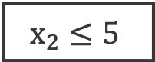
Decision Trees: Numerical Example
x₂
Class 1
Class 2
$$x_{2}≤5$$
9
8
7
6
5
4
3
2
1
Yes
No
Class: 1, 2
Class = 1
What feature (x₁ or x₂) to use to split the dataset, to best separate class 1 from class 2?
5
1 2 3 4 5 6
x₁

Slide 12
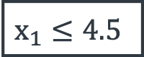
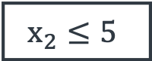
Decision Trees: Numerical Example
x₂
Class 1
Class 2
$$x_{2}≤5$$
$$x_{2}≤5$$
9
8
7
6
5
4
3
2
1
Yes
No
$$x_{1}≤4.5$$
Class = 1
Yes
No
5
Class = 2
Class: 1, 2
What feature (x₁ or x₂) to use to split the dataset, to best separate class 1 from class 2?
4.5
x₁
1 2 3 4 5 6

Slide 13
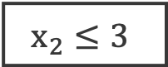
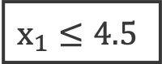
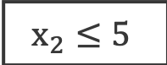
Decision Trees: Numerical Example
x₂
Class 1
Class 2
$$x_{2}≤5$$
$$x_{2}≤5$$
9
8
7
6
5
4
3
2
1
Yes
No
$$x_{1}≤4.5$$
Class = 1
Yes
No
5
Class = 2
$$x_{2}≤3$$
3
Yes
No
Class = 1
Class = 2
4.5
x₁
1 2 3 4 5 6

Slide 14
Decision Trees: Example
Weather | Demand | Address | ontime
Sunny | High | Correct | No
Sunny | High | Misspelled | No
Overcast | High | Correct | Yes
Rainy | High | Correct | Yes
Rainy | Normal | Correct | Yes
Rainy | Normal | Misspelled | No
Overcast | Normal | Correct | Yes
Sunny | High | Correct | No
Sunny | Normal | Correct | Yes
Rainy | Normal | Misspelled | Yes
Sunny | Normal | Misspelled | Yes
Overcast | High | Misspelled | Yes
Overcast | Normal | Correct | Yes
Rainy | High | Misspelled | No
Class: Yes, No
What feature (’Weather’, ‘Demand’ or ‘Address’) to use to split the dataset, to best separate class ‘No’ from class ‘Yes’?
[select the splits such that the descendent subsets are “purer” than their parents]

Slide 15
Best Feature to Split with?
A good split results in overall less uncertainty (impurity). For example:
Weather | Demand | Address | ontime
Sunny | High | Correct | No
Sunny | High | Misspelled | No
Overcast | High | Correct | Yes
Rainy | High | Correct | Yes
Rainy | Normal | Correct | Yes
Rainy | Normal | Misspelled | No
Overcast | Normal | Correct | Yes
Sunny | High | Correct | No
Sunny | Normal | Correct | Yes
Rainy | Normal | Misspelled | Yes
Sunny | Normal | Misspelled | Yes
Overcast | High | Misspelled | Yes
Overcast | Normal | Correct | Yes
Rainy | High | Misspelled | No
Not too sure
[9+, 5-]
Weather
Sunny
Rainy
Overcast
[2+, 3-]
Not too sure
[3+, 2-]
[4+, 0-]
Not too sure
Absolutely sure
Notes:
splits on nominal features have one branch per value • splits on continuous features use a threshold

Slide 16
Best Feature to Split with?
A good split results in overall less uncertainty (impurity). For example:
Weather | Demand | Address | ontime
Sunny | High | Correct | No
Sunny | High | Misspelled | No
Overcast | High | Correct | Yes
Rainy | High | Correct | Yes
Rainy | Normal | Correct | Yes
Rainy | Normal | Misspelled | No
Overcast | Normal | Correct | Yes
Sunny | High | Correct | No
Sunny | Normal | Correct | Yes
Rainy | Normal | Misspelled | Yes
Sunny | Normal | Misspelled | Yes
Overcast | High | Misspelled | Yes
Overcast | Normal | Correct | Yes
Rainy | High | Misspelled | No
Not too sure
[9+, 5-]
Not too sure
[9+, 5-]
Demand
Address
High
Normal
Correct
Misspelled
[3+, 4-]
[1+, 6-]
[6+, 2-]
[3+, 3-]
Not too sure
Somewhat sure
Somewhat sure
Not too sure

Slide 17
Best Feature to Split with?
What split will results in overall less uncertainty (impurity)?
Not too sure
Not too sure
Not too sure
[9+, 5-]
[9+, 5-]
[9+, 5-]
Weather
Demand
Address
Sunny
Rainy
High
Normal
Correct
Misspelled
Overcast
[2+, 3-]
Not too sure
[3+, 2-]
[3+, 4-]
[1+, 6-]
[6+, 2-]
[3+, 3-]
[4+, 0-]
Not too sure
Absolutely sure
Not too sure
Somewhat sure
Somewhat sure
Not too sure

Slide 18
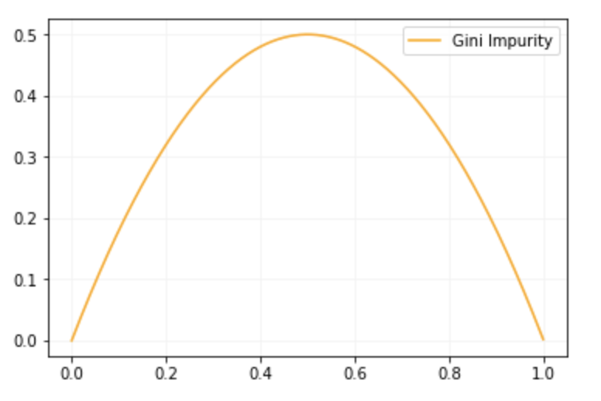
How to Measure Uncertainty
We will use Gini impurity:
( : number of classes, : prob. of picking a datapoint from class )
Another measure:
Entropy: More details
Gini Impurity curve
-
-
-
-
+
-
+
+
+
-
-
-
+
-
+
+
+
+
-
-
-
+
+
+
Notes:
i(p_{1},...,p_{k}) = \sum_{k=1}^{n}p_{k}(1-p_{k})

Slide 19
How to Measure Uncertainty
We will use Gini impurity:
( : number of classes, : prob. of picking a datapoint from class )
Gini Impurity curve
If we have only + samples or only – samples:
Low uncertainty
-
-
-
-
+
-
+
+
+
-
-
-
+
-
+
+
+
+
-
-
-
+
+
+

Slide 20
How to Measure Uncertainty
We will use Gini impurity:
( : number of classes, : prob. of picking a datapoint from class )
Gini Impurity curve
If we have mix of + and - samples:
High uncertainty
-
-
-
-
+
-
+
+
+
-
-
-
+
-
+
+
+
+
-
-
-
+
+
+

Slide 21
Information Gain & Feature Selection
Information Gain: Expected reduction in uncertainty due to selected feature.
“Weather”, “Demand” or “Address”, which one should we select as feature to split?
Gain =
Impurity before split
Impurity after split
[9+, 5-]
[9+, 5-]
[9+, 5-]
Weather
Demand
Address
Sunny
Rainy
Misspelled
Correct
Overcast
High
Normal
Notes:
i(p_{1},...,p_{k})_{before} - i(p_{1},...,p_{k})_{after}

Slide 22
Calculating Gini Impurity
Gini impurity:
Not too sure
[9+, 5-]
Weather
Sunny
Rainy
Overcast
[2+, 3-]
Not too sure
[3+, 2-]
[4+, 0-]
Not too sure
Absolutely sure
Notes:
Gini impurity = 0.46 translates into ‘there is 46% chance of a new data point being incorrectly classified’, based on the observed training data we have at our disposal. This number makes sense, since there is quite a mix of yes and no in the data, so the probability of mis-classifying something is slightly less than a coin flip.
Overcast leaf = pure. A leaf node is said to be pure if all of its examples belong to the same class.
i(p_{1},...,p_{k}) = \sum_{i=1}^{k}p_{k}(1-p_{k})
i_{before} = 0.46
i_{before} = \frac{9}{14}*\frac{5}{14} + \frac{5}{14}*\frac{9}{14} = 0.46
i_{sunny} = \frac{2}{5}*\frac{3}{5}+\frac{3}{5}*\frac{2}{5} = 0.48
i_{overcast} = \frac{4}{4}*\frac{0}{4}+\frac{0}{4}*\frac{4}{4} = 0
i_{rainy} = \frac{3}{5}*\frac{2}{5}+\frac{2}{5}*\frac{3}{5} = 0.48

Slide 23
Calculating Gini Impurity
Gini impurity:
Not too sure
[9+, 5-]
Weather
Sunny
Rainy
Overcast
[2+, 3-]
Not too sure
[3+, 2-]
[4+, 0-]
Not too sure
Absolutely sure
(Weighted sum of impurities)
Notes:
Gini impurity = 0.46 translates into ‘there is 46% chance of a new data point being incorrectly classified’, based on the observed training data we have at our disposal. This number makes sense, since there is quite a mix of yes and no in the data, so the probability of mis-classifying something is slightly less than a coin flip.
Overcast leaf = pure. A leaf node is said to be pure if all of its examples belong to the same class.
i(p_{1},...,p_{k}) = \sum_{i=1}^{k}p_{k}(1-p_{k})
i_{before} = 0.46
i_{before} = \frac{9}{14}*\frac{5}{14} + \frac{5}{14}*\frac{9}{14} = 0.46
i_{sunny} = \frac{2}{5}*\frac{3}{5}+\frac{3}{5}*\frac{2}{5} = 0.48
i_{overcast} = \frac{4}{4}*\frac{0}{4}+\frac{0}{4}*\frac{4}{4} = 0
i_{rainy} = \frac{3}{5}*\frac{2}{5}+\frac{2}{5}*\frac{3}{5} = 0.48

Slide 24
Information Gain & Feature Selection
Not too sure
[9+, 5-]
Gain =
Weather
Impurity before split
Impurity after split
Sunny
Rainy
Overcast
[2+, 3-]
Not too sure
[3+, 2-]
Gain(“Weather”) = 0.46-0.34=0.12
[4+, 0-]
Not too sure
Absolutely sure
Notes:
Gini impurity = 0.46 translates into ‘there is 46% chance of a new data point being incorrectly classified’, based on the observed training data we have at our disposal.
So how do we use this when building a decision tree?
Information Gain, or Gini Gain
Gini gain is calculated when building a decision tree to help determine which attribute gives us the most information about which class a new data point belongs to.
i(p_{1},...,p_{k}) = \sum_{i=1}^{k}p_{k}(1-p_{k})
i_{weather} = \frac{5}{14}*i_{sunny} + \frac{4}{14}*i_{overcast} + \frac{5}{14}*i_{rainy}

Slide 25
Information Gain & Feature Selection
Comparing gains for each feature:
Gain(“Weather”) = 0.46-0.34 = 0.12
Gain(“Demand”) = 0.46-0.37 = 0.09
Gain(“Address”) = 0.46-0.43 = 0.03
“Weather” has the highest gain of all, so we start the tree with the “Weather” feature as the root node!
[9+, 5-]
[9+, 5-]
Demand
Address
High
Normal
Correct
Misspelled
[3+, 4-]
[1+, 6-]
[6+, 2-]
[3+, 3-]
Notes:
i_{demand} = \frac{7}{14}*0.49 + \frac{7}{14}*0.245 = 0.37
i_{address} = \frac{8}{14}*0.38 + \frac{6}{14}*0.5 = 0.43

Slide 26
Recap ID3 Algorithm
ID3 Algorithm*: Repeat
Select “the best feature” to split using Information Gain.
Separate the training samples according to the selected feature.
Stop if have samples from a single class or if all features used, and note a leaf node.
Assign the leaf node the majority class of the samples in it.
Feature with highest Information Gain
A
B
C
Feature with highest Information Gain given A
Feature with highest Information Gain given C
D
E
Class 1
F
G
Class 2
Class 1
Class 2
Class 1
*To build a Decision Tree Regressor: 1. Replace the Information Gain with Standard Deviation Reduction. 3. Stop when numerical values are homogeneous (standard deviation is zero) or if used all features, and note it as a leaf node. 4. Assign the leaf node the average value of its samples.

Slide 27
Ensemble Methods

Slide 28
Ensemble Learning
Ensemble methods create a strong model by combining the predictions of multiple weak models (aka weak learners or base estimators) built with a given dataset and a given learning algorithm.
We discuss Bagging and Boosting ensemble models.
Weak Model 1
Weak Model 2
Ensemble Prediction
Data
…
Weak Model N
Notes:
The goal of ensemble methods is to combine the predictions of several weak models,
built with a given learning algorithm, on a given dataset,
in order to improve over a single model.
1st Ensembles can be applied to both REGR and CLASS problems
2nd Weak models aka base estimators, are weak learners, that is, performance wise these models
are slightly better than random chance/guessing/coin toss,
So, let’s see how ensembling might work…given a particular task and dataset,
with an alg of choice, say a decision tree, and not very happy with the predictions,
somehow thinking to build more decision trees, using the same dataset,
with the scope of combining all their predictions to outperform your initial tree model. …
Q1: How to train multiple learners such that they're actually different?
Because if the dataset is the same and the alg is the same, will be the same model/prediction N times, not very useful
How/what to change a bit to get different models?
Q2: When figured how to get these diff models, how to combine them/their predictions to get one prediction to beat all individual ones?
We will discuss the following ensemble models :
Bagging: building independent estimators on different samples of the original dataset, and average or vote across all their predictions
Boosting: building estimators sequentially, each subsequent one attempting to boost performance overall, by overcoming/reducing the errors of the previous one
Other ensemble methods:
Voting
Stacking

Slide 29
Bagging (Bootstrap Aggregating)
Bagging (Bootstrap Aggregating) method:
Randomly draw N samples of a fix size from the training set (with replacement) - bootstrap technique
Example: given data [1, 2, 3, 4, 5, 6, 7, 8, 9], samples of size 6 are:
[ 1, 1, 2, 4, 9, 9]; [ 2, 4, 5, 5, 7, 7]; [ 1, 1, 1, 1, 1, 1]; [ 1, 2, 4, 5, 7,9]
Build independent estimators of same type on each subset
Majority vote or average the predictions from all estimators
Bagging Decision Trees: Random Forest
Notes:
The way Bagging works, short for Bootstrap Aggregating
Given a task/dataset, and a choice of a simple ML alg/weak model,
One idea to train multiple models having access to only one dataset, such that they're actually different models, is to
1st Resample the data multiple times, say N times,
by bootstrapping (sample with replacement) from original dataset: that is, sample a data point, put it back, sample again until fill in the sample of desired size; move on the the next sample until have as many as desired;
[usually 63.2% of the original dataset would be in the sample, the rest would be repeats]
This will magically produce more datasets from your original data!
2nd On each sample dataset build a simple model like you know
3rd Then vote across all your models predictions
Note the ”independent” estimators here, which implies that bagging could easily be parallelized for speed and functionality!
While you can bag any estimators, the most popular bagging model is bagging trees, known as Random Forest
Bagging, is in particular useful when you have estimators that have a variance problem:
identify this by having your training errors much much lower than the val/test error
Bagging reduces the variance, does not increase bias, therefore the test error goes down.

Slide 30
Bagging trees: Random Forest
Random Forest: Bagging Decision Trees
Draw random subsets (with replacement) from the original dataset
Build a decision tree on each bootstrapped subset
Combine predictions from each tree for final prediction
Data 1
Tree 1
Prediction 1
Data 2
Tree 2
Prediction 2
Prediction
Data
…
…
…
Data N
Tree N
Prediction N
Notes:
Bagging Decision Trees
~~~~~~~~~~~~~~~~~~
Random Forest: Combination of multiple trees.
Draw random subsets (with replacement) from the original dataset: generating N datasets, Data 1, Data 2, and so on…
Build a decision tree on each bootstrapped subset
Combine metrics from each tree for final prediction

Slide 31
Random Forest in sklearn
RandomForestClassifier: sklearn Random Forest classifier (there is also a Regressor version) -
RandomForestClassifier(n_estimators=100, max_samples =None criterion='gini’, max_depth=None, min_samples_split=2,
min_samples_leaf=1, class_weight=None)
The full interface is larger.
.fit(), .predict()
Notes:
Random Forest Classifier / Regressor are easy to use from the sklearn library’s ensemble module, like this:
….
Notice the mix of bagging-specific and tree-specific parameters:
We discussed the tree specific paratemers,
So some of The Bagging-specific parameters are:
n_estimators (default 100) = the number of trees to be modeled
max_ samples (default None) = the number of samples to draw from original data to train each tree (the size of the bootstrapped subsets)
Tree-specific parameters…
criterion (gini) = what to use to decide the splits (entropy as well)
max_depth (None) = The maximum depth of a tree.
Used to control over-fitting as Higher depth will allow model to learn relations very specific to a particular sample.
min_samples_split (2) = Defines the minimum number of samples (or observations) which are required in a node to be considered for splitting.
Used to control over-fitting as Higher values prevent a model from learning relations which might be highly specific to the particular sample selected for a tree. Too high values can lead to under-fitting hence, it should be tuned using CV.
min_samples_leaf (1) = Defines the minimum samples (or observations) required in a terminal node or leaf.
Used to control over-fitting similar to min_samples_split.
Generally lower values should be chosen for imbalanced class problems because the regions in which the minority class will be in majority will be very small.
Class_weight (none) = Weights associated with classes in the form: {class_label: weight}
The “balanced” mode uses the values of y to automatically adjust weights inversely proportional to class frequencies in the input data

Slide 32
Bagging in sklearn
BaggingClassifier: sklearn very general interface for bagging which can be provided any base_estimator -
BaggingClassifier(base_estimator=None, n_estimators=10,
max_samples=1.0, bootstrap=True)
The full interface is larger.
.fit(), .predict()
Notes:
Sklearn has also a more general interface for bagging which can be provided any base_estimator – classifier or regressor
This algorithm encompasses several works from the literature
when
boostrap = True (default)
That is, When random subsets of the dataset are drawn as random subsets with replacement,
then the method implementing is Bagging a discussed previously.
max_samples, default=1.0
The number of samples to draw from X to train each base estimator
(with replacement by default, see bootstrap for more details).

Slide 33
Regression Models
Notes:
All looked/worked great with our toy dataset, but real life data – that’s another (long) story
how much data: more data samples, more features
what type of data: numerical, categorical, text (not all numbers ?!)
missing values
different scales (large/small) numerical values
outliers

Slide 34
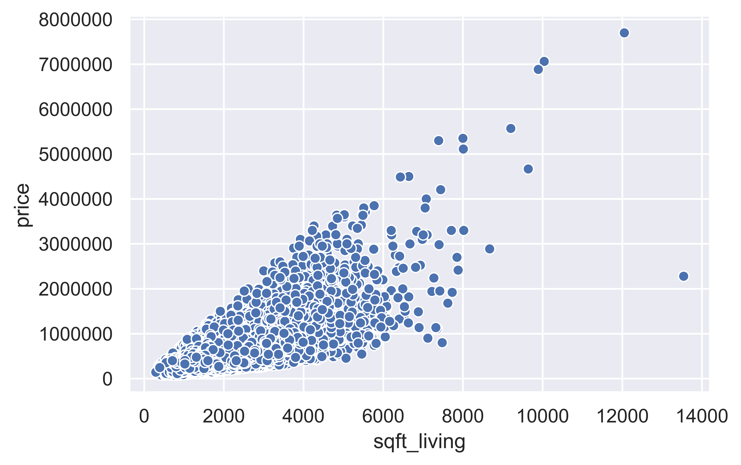
Linear Regression
It models the relationship between two variables x and y with a “line”.
Linear regression formula: $y=w_{0}+w_{1}x,$ where
x: feature, attribute; y: target, outcome; w₀: intercept; w₁: slope
Example: How does the price of a house (y) change relate to its living square footage (x)?
* Data source: King County, WA Housing Info.

Slide 35
Linear Regression
Given data (x, y), the regression line
$$y=w_{0}+w_{1}x$$
is defined by $w_{0}$(intercept) and $w_{1}$ (slope)
The vertical offset for each data point from the regression line is the error between the true label y and the prediction based on x
The “best” line minimizes the sum of the squared errors (SSE): $\sum{{\left(y_{i}−{\hat{y}}_{i}\right)}^{2}}$
y
vertical offset = | $\hat{y}$- y |
$$\hat{y}=w_{0}+w_{1}x$$
$$∆y$$
$$∆x$$
w₁(slope) = $∆y$/$∆x$
w₀ (Intercept)
x

Slide 36
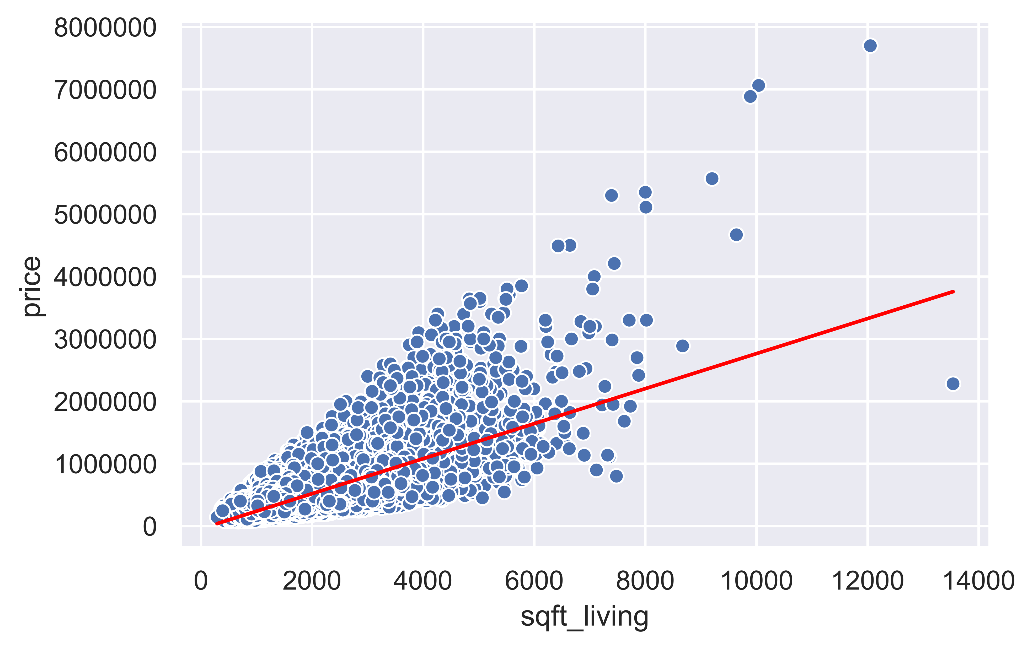
Linear Regression
Linear regression fits the “best” line to fit:
x: sqft_living; y: price; w₀: intercept; w₁: slope
$$price=w_{0}+w_{1}∗sqft_living$$
w_{0:} Intercept = -43580.74
w_{1:} Slope = 280.62
For $sqft_living$= 6000,
$price$ = -43580.74 + 280.62*6000
= $1,640,139.26

Slide 37
Linear Regression
For multiple features ($x_{1},x_{2}, …x_{m}$), the equation extends to:
$$y=w_{0}+w_{1}x_{1}+ … +w_{m}x_{m}$$
Example: Predict house prices ($y$) using multiple features: number of bedrooms ($x_{1}$), square feet living space ($x_{2}$), number of bathrooms ($x_{3}$), and number of floors ($x_{4}$)
bedrooms | sqft_living | bathrooms | floors | price ($)
3 | 1180 | 1.00 | 1.0 | 221900.0
3 | 2570 | 2.25 | 2.0 | 538000.0
2 | 770 | 1.00 | 1.0 | 180000.0
4 | 1960 | 3.00 | 1.0 | 604000.0
.. | .. | .. | .. | ..

Slide 38
Linear Regression
Example (continued):
Calculated regression coefficients:
Regression equation:
Using the regression equation: Assuming all other variables stay the same, increasing $sqft_living$ by 1 foot square, increases the $price$ by $$\text{309.39}$.
w₀ (intercept) | w₁ (bedrooms) | w₂ (sqft_living) | w₃ (bathrooms) | w₄ (floors)
74669.67 | -57847.96 | 309.39 | 7853.52 | 200.497
$y=\text{74669.67} \text{−} \text{57847.96} x_{1}+\text{309.39} x_{2}$ $+\text{7853.52} x_{3}+\text{200.497}{ x}_{4}$

Slide 39
Logistic Regression
Linear regression was useful when predicting continuous values
$$y=w_{0}+w_{1}x_{1}+ … +w_{m}x_{m}$$
Can we use a similar approach to solve classification problems?
Binary classification examples (y $∈${0, 1}):
Email: Spam or Not Spam
Text: Positive or Negative product review
Image: Cat or Not Cat

Slide 40
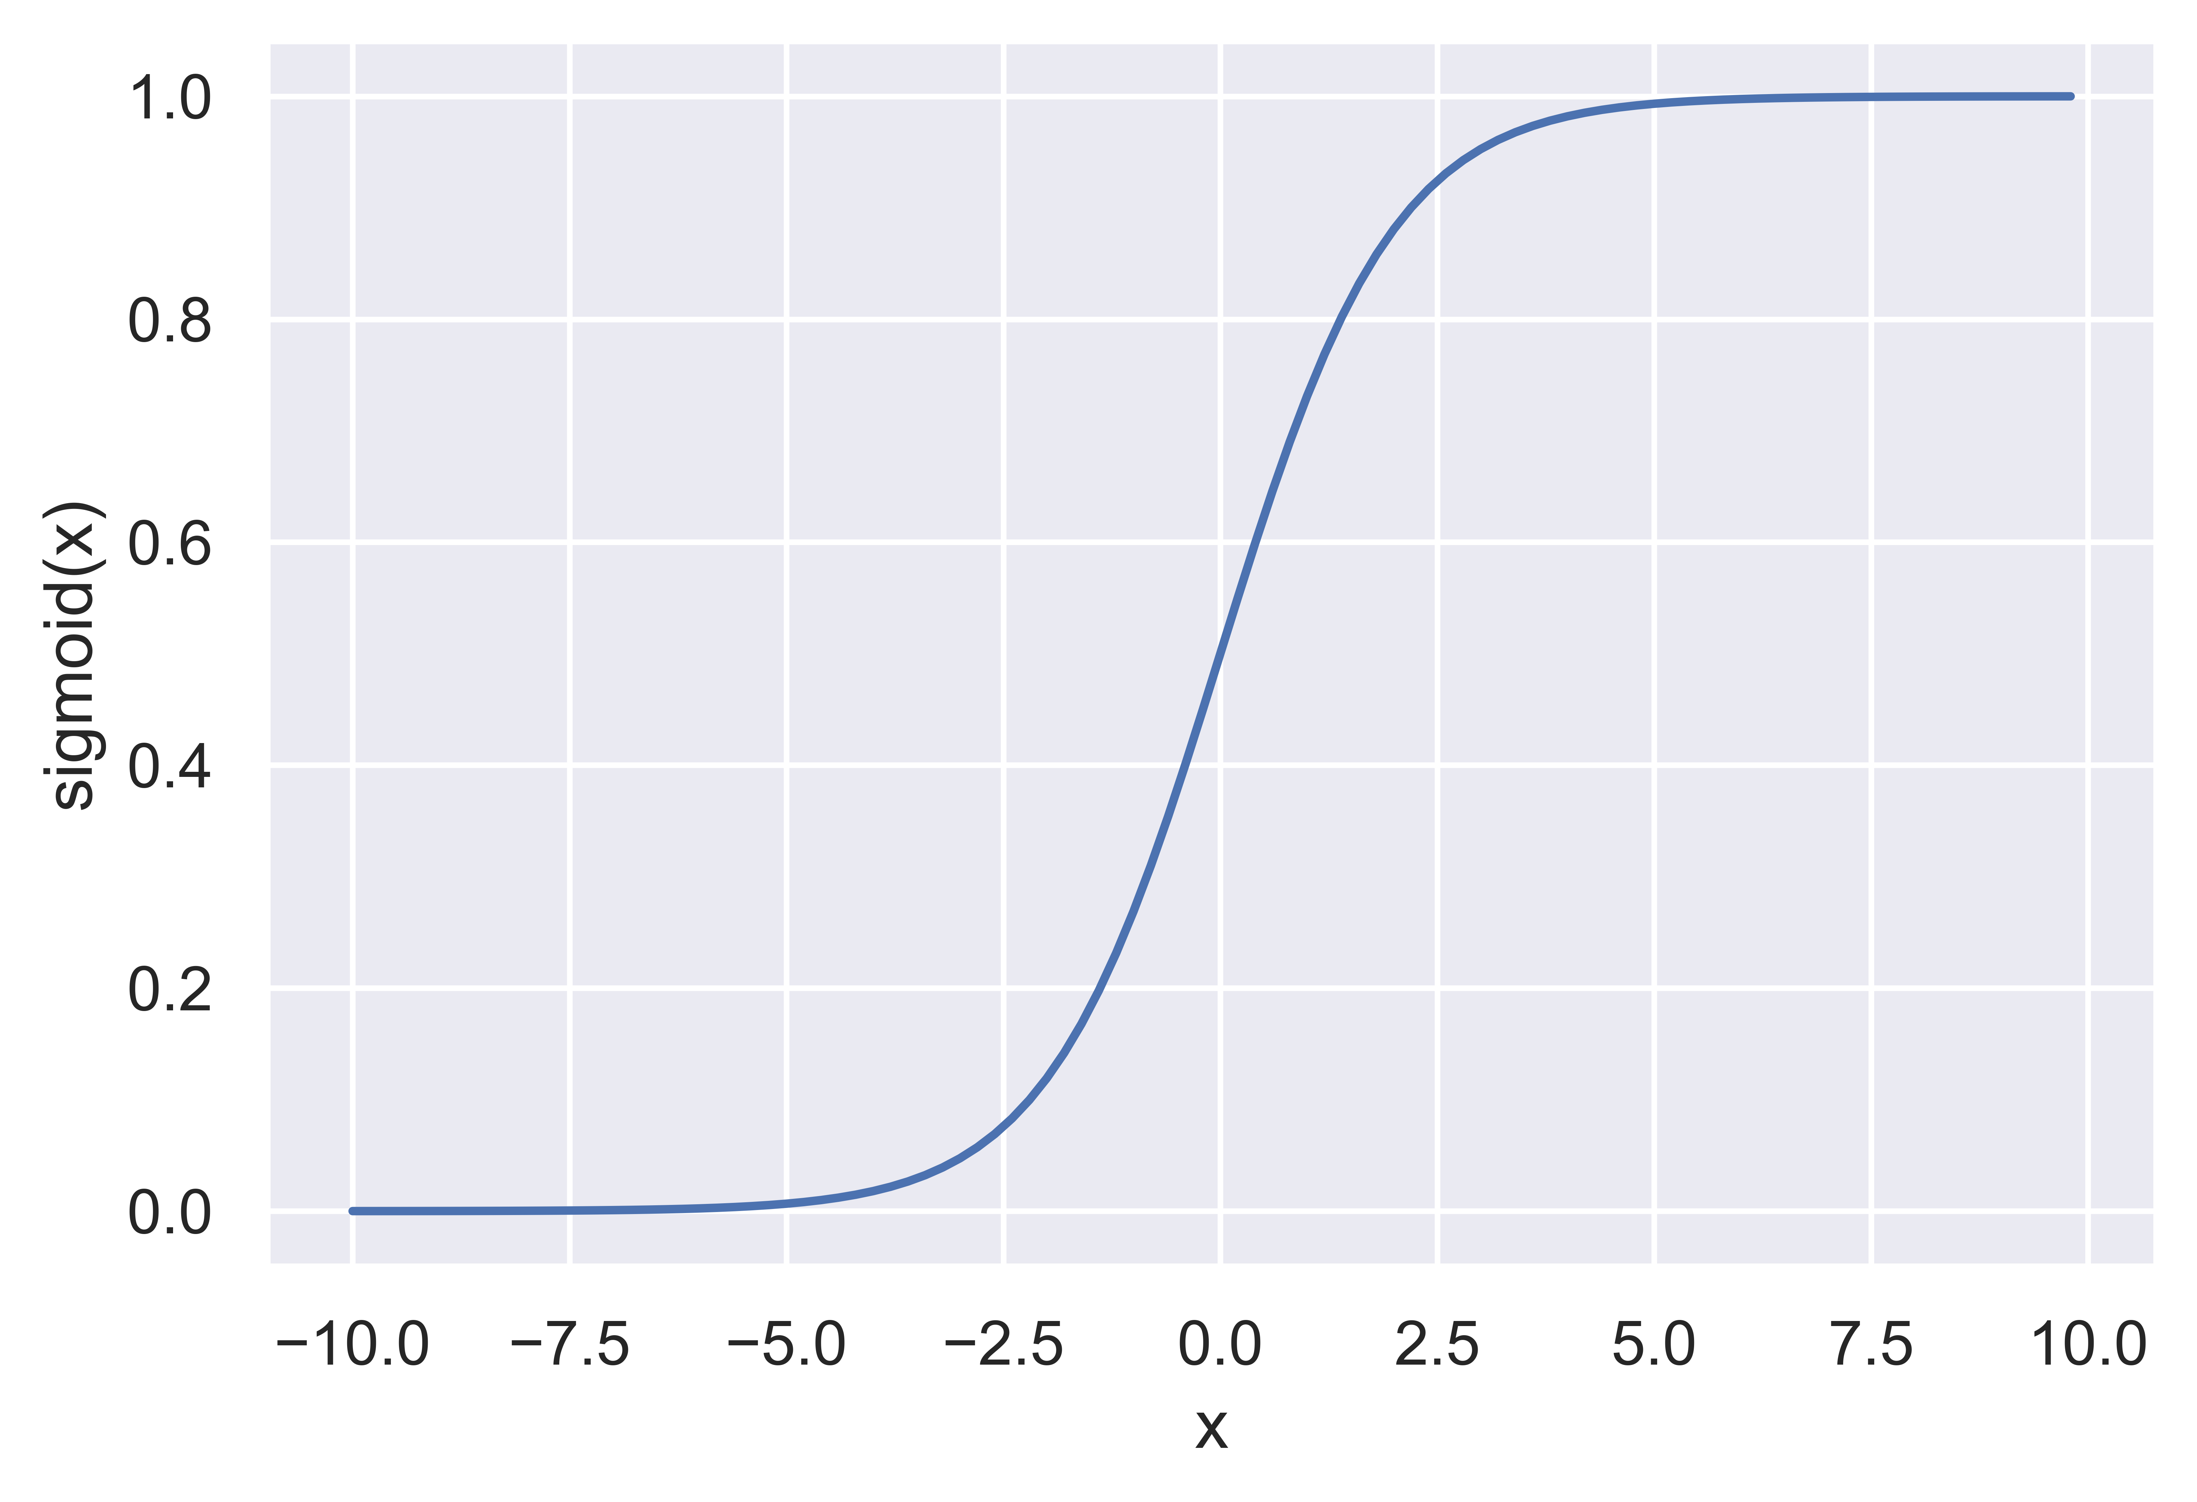
Logistic Regression
Idea: We can apply the Sigmoid function to $y=w_{0}+w_{1}x_{1}+ … +w_{m}x_{m}$
The Sigmoid (Logistic) function
$$sigmoid\left(y\right)= \frac{1}{1+e^{−y}}$$
“squishes” $y$values to the 0 – 1 range.
Can define a “threshold” at 0.5
if $sigmoid\left(y\right)<$ 0.5, class 0
if $sigmoid\left(y\right)≥$ 0.5, class 1
Our regression equation becomes:
$$y=sigmoid(w_{0}+w_{1}x_{1}+ … +w_{m}x_{m})$$

Slide 41
Log-loss (Binary Cross-Entropy)
Log-Loss: A numeric value that measures the performance of a binary classifier when model output is a probability between 0 and 1.
A suitable loss function for the Logistic Regression.
To improve model learning from the data, we want to minimize it.
In mathematical terms,
$$LogLoss=−\left(y∗log\left(p\right)+\left(1−y\right)∗\log\left(1−p\right)\right)$$
where
$y$: true class $∈${0, 1}, p: probability of class (i.e. $sigmoid\left(y\right)$), log: logarithm

Slide 42
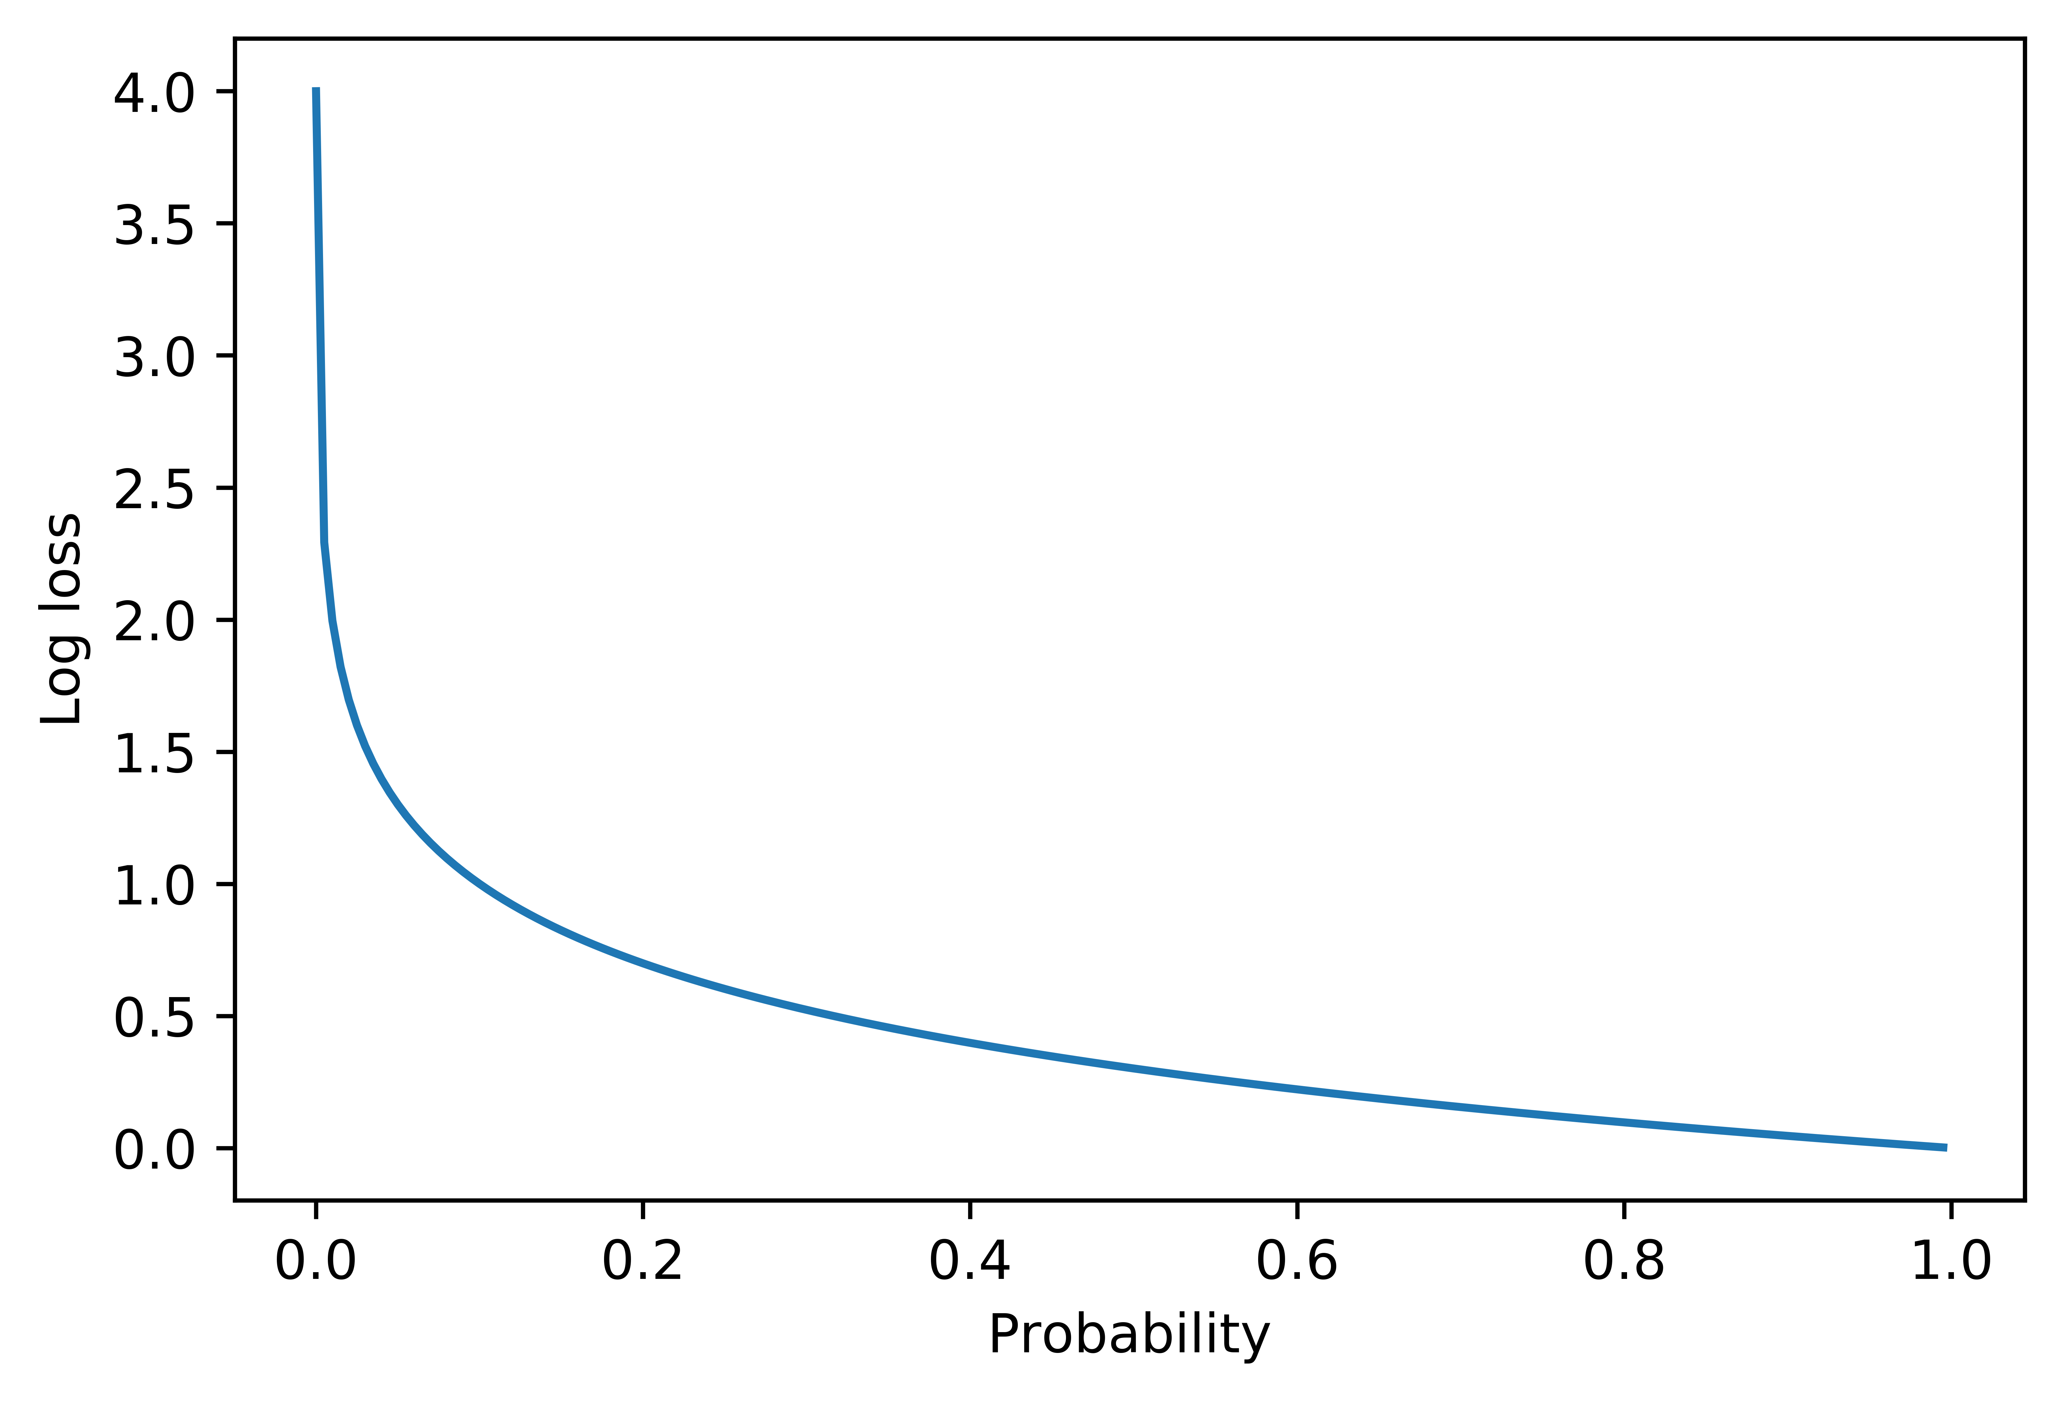
Log-loss (Binary Cross-Entropy)
Example: Let’s calculate the Log-Loss
for the following scenarios:
$y$: true class $=1,$p = 0.3
$y$: true class $=1,$p = 0.8
LogLoss when y=1
$$−(1∗log\left(0.3\right)+\left(1−1\right)∗\log\left(0.7\right))=0.52$$
$$−(1∗log\left(0.8\right)+\left(1−1\right)∗\log\left(0.2\right))=0.1$$
Better prediction gives smaller loss
$$LogLoss=−\left(y∗log\left(p\right)+\left(1−y\right)∗\log\left(1−p\right)\right)$$

Slide 43

Logistic Regression – Hands-on
Exercise: Training a classifier to predict the isPositive field for the review dataset:
The exercise covers the following topics:
ML Model: Logistic Regression
Model Evaluation: Probability Threshold Calibration
MLA-NLP-Lecture2-Logistic-Regression.ipynb

Slide 44
Optimization
Notes:
Let’s talk about Machine Learning Model Optimization.
Specifically about model optimization by Gradient Descent.
The basic idea behind this optimization method is to iteratively update an ML model
such that the overall error model decreases with each update.
What better way to update the model to minimize its errors,
Other than going away/avoiding large errors, guided by a negative gradient!
That is, in a nutshell, the Gradient Descent!

Slide 45
Optimization in Machine Learning
We build and train ML models, hoping for:
In reality …
Learn better and better models, such that overall model error gets smaller and smaller … ideally, as small as possible!
ML Model Features
ML Model (Rules)
ML Model Target
error
ML Model Features
ML Model (Rules)
ML Model Prediction
Notes:
Every ML model aims to take in the model features and match the model target.
In reality, almost all ML models take in the model features and make model predictions that
rarely match the model target exactly…some error occurs!
So, the holy grail of ML is learning better and better models, such that overall model error gets smaller and smaller … ideally, as small as possible! (think global minimum kind of low)

Slide 46
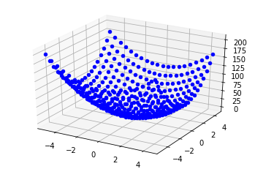
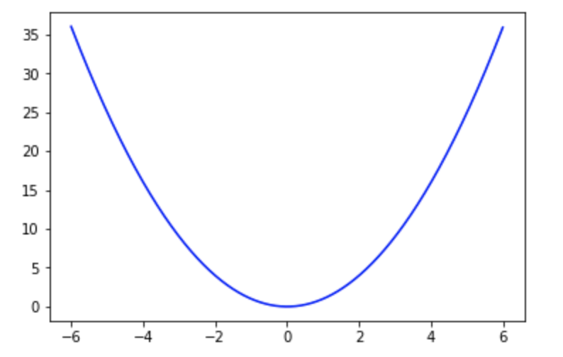
Optimization
In ML, use optimization to minimize an error function of the ML model
Error function: , where = input, = function, = output
Optimizing the error function:
Minimizing means finding the input that results in the lowest value
Maximizing, means finding that gives the largest
Notes:
Let’s consider an ML model, that makes some error.
That error depends on the predictions of the model, therefore depends on the ML model…
Or should we rather say, it depends on the ML model’s parameters, let’s called them collectively w (w like in weights)
So let’s then think of the ML model’s error as a function of w: let’s call it f(w)
When plotting this error fct, it can look as either one of the plots shown below here, for a ML model with 1-feature, or for a ML model with 2-features
It could be, that:
For some model, or should we say for some value of w as a input, we get an error value - maybe the blue dots in the plots below
For another model, or should we say for another value of w as a input, we get another error value - maybe the orange dots in the plots below
Now, Some of these error values look smaller than others, for example the orange dots sit lower than the blue dots, the orange dots are sitting as low as possible actually…
It happens that the orange dots sit at the global minimum of these error functions!
We could then say, that the orange dots Ws are the parameters of our best ML models, with the lowest possible errors!
With the best model out there being the one that generates the lowest possible error,
ML’s main problem becomes an optimization problem!
Now, If my current ML model is not a very good model, say its parameters are one of the blue dots, generating higher errors,
how should my model change, or equiv., how should its parameters change to move closer to,
maybe even into, the global minimum position of the orange dots?
Looking at the 1D error fct plot: with the blue dot sitting ~ w = 2, you’d say, need to move a little to the left
Looking at the 2D error fct plot: with the blue dot sitting ~ (w1, w2) = (3,2), you’d say, need to move a little to the left, and a little down
While it seems so easy to visualize and craft a path towards the minimum for models with these choice of error fcts, and 1 or 2 features,
things can get more complex as our error fct (aka loss/cost function) gets more complicated,
Or as we add more features/dimensions (in which case, we loose the luxury of visualization all together!)
So, we can only imagine, that a similar simpler rule would help us navigate the blue dot towards the minimum orange dot, from whatever (worst, higher) initial position?
Something like, “move a little to the left/right in x1, move a little to up/down in x2, etc…for how many features/dimensions are there!

Slide 47
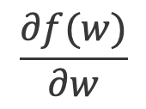
Gradient Optimization
Gradient: direction and rate of the fastest increase of a function.
It can be calculated with partial derivatives of the function with respect to each input variable in :
Because it has a direction, the gradient is a “vector”.
$$\frac{∂f(w)}{∂w}$$
Notes:
Luckily this simpler NDimensional rule exists, at least for some well behaved error fcts f(w), for which, given a value/position w,
the derivative of the fct at that position (in 1d) or the so-called partial derivatives at that position (in higher dim space) exist!
Turns out that the collection of all partial derivates of a fct at a given position,
(basically just a collection of numerical values, right, a vector)
is a vector that points in the direction of fastest increase of the fct,
So appropriately called the gradient of the fct at that position!
Therefore, moving in the direction of the gradient should get us the fastest to the maximum of the fct!
Now, the ML quest is to get the fastest to the min of the error fct,
so the golden ML optimization rule would says something like:
Moving in the direction of the negative gradient should get us the fastest to the minimum of the fct!
Let’s get some intuition on how this might work, for the 1-feature example here:

Slide 48
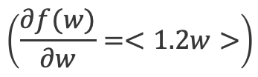
Gradient Example
$$\left(\frac{∂f(w)}{∂w}=<1.2w>\right)$$
, with gradient vector
Sign of the gradient shows direction the function increases: + right and – left
Notes:
For only one feature model, and therefore one weight w,
If the error fct is a quadratic fct, like 0.6w^2 (think sum of squared errors like), the gradient is computed to be 1.2w:
Which means that at w=2, grad = + 2.4
As the Sign of the gradient shows direction the function increases, pointing to the right,
we should move in the opposite direction, to the left to decrease the value of the blue error fct
Note that if we move all the way 2.4 units to the left, we might beyond the minimum!
So although we know we need to go in the opposite direction of the gradient,
we might want to take a smaller step, not the full size of the gradient, but rather proportional to the gradient,
and control this step size by a parameter … keep that thought!
(this tactic would also take care of other scenarios, when the error fct is, say less curved up, and the step needs to be larger than the size of the gradient, and so on…)
~~~~~~~~~~
\nabla{f}(2) = <2.4> \,\Rightarrow |\nabla{f}(2)| = 2.4
\nabla{f}(-3) = <-3.6> \,\Rightarrow |\nabla{f}(-3)| = 3.6
\nabla{f}(4) = <4.8> \,\Rightarrow |\nabla{f}(4)| = 4.8
\nabla{f}(0) = <0> \,\Rightarrow |\nabla{f}(0)| = 0

Slide 49
Gradient Example
$$\left(\frac{∂f(w)}{∂w}=<1.2w>\right)$$
, with gradient vector
Sign of the gradient shows direction the function increases: + right and – left
Notes:
Let’s look now at w=4, grad = + 4.8
Again the Sign of the gradient shows direction the function increases,
And so we should move to the left to decrease the value of the error fct,
again, maybe smaller than the size of the gradient, and rather proportional to the gradient
~~~~~~~~~~
\nabla{f}(2) = <2.4> \,\Rightarrow |\nabla{f}(2)| = 2.4
\nabla{f}(-3) = <-3.6> \,\Rightarrow |\nabla{f}(-3)| = 3.6
\nabla{f}(4) = <4.8> \,\Rightarrow |\nabla{f}(4)| = 4.8
\nabla{f}(0) = <0> \,\Rightarrow |\nabla{f}(0)| = 0

Slide 50
Gradient Example
$$\left(\frac{∂f(w)}{∂w}=<1.2w>\right)$$
, with gradient vector
Sign of the gradient shows direction the function increases: + right and – left
As we go towards to the bottom part of the function, gradient gets smaller
Notes:
Let’s also try w=-3, grad = - 3.6
Now the Sign of the gradient is –”, showing the direction the function increases to the left,
And so we should take a step proportional to the gradient, to the right, to decrease the value of the error fct,
Also, note that, as we go towards to the bottom part of the function, gradients gets smaller ….
Grad size at 2 is smaller than at 3 and at 4, etc…
~~~~~~~~~~
\nabla{f}(2) = <2.4> \,\Rightarrow |\nabla{f}(2)| = 2.4
\nabla{f}(-3) = <-3.6> \,\Rightarrow |\nabla{f}(-3)| = 3.6
\nabla{f}(4) = <4.8> \,\Rightarrow |\nabla{f}(4)| = 4.8
\nabla{f}(0) = <0> \,\Rightarrow |\nabla{f}(0)| = 0

Slide 51
Gradient Example
$$\left(\frac{∂f(w)}{∂w}=<1.2w>\right)$$
, with gradient vector
Sign of the gradient shows direction the function increases: + right and – left
As we go towards to the bottom part of the function, gradient gets smaller and becomes zero (i.e., function can no longer change, can no longer decrease – it reached the min!)
Notes:
As we go towards to the bottom part of the function, … gradients get smaller and become zero,
i.e., function can no longer change, can no longer decrease – it reached the min!
Overall, it seems like a good strategy to move in the opposite direction of the gradient to get to the minimum….
~~~~~~~~~~
\nabla{f}(2) = <2.4> \,\Rightarrow |\nabla{f}(2)| = 2.4
\nabla{f}(-3) = <-3.6> \,\Rightarrow |\nabla{f}(-3)| = 3.6
\nabla{f}(4) = <4.8> \,\Rightarrow |\nabla{f}(4)| = 4.8
\nabla{f}(0) = <0> \,\Rightarrow |\nabla{f}(0)| = 0

Slide 52

Gradient Descent Method
Gradient Descent method uses gradients to find the minimum of a function iteratively.
Taking steps (proportional to the gradient size) towards the minimum, in the opposite direction of the gradient.
Gradient Descent Algorithm:
Start at an initial point
Update:
Notes:
To summarize, this is the so-called Gradient Descent method
that uses gradients to find the minimum of a function iteratively.
Specifically, taking steps proportional to the gradient size
towards the minimum – that is, in the opposite direction of gradient.
Gradient Descent Algorithm:
From any initial point w – presumably not at min (so the grad is not zero!)
Move towards the min, updating the w by small/large steps in the opposite direction of gradient
The size of the update, is controlled by this step_size parameter, also known in ML as the learning rate!
If the step size is too small, the algorithm might take a long time to converge,
or might actually never quite reach the global minimum!
…more complicated scenarios can occur, for example when the step_size is too large…
~~~~~~~~~~
w_{new} = w_{current} - step\_ size * gradient

Slide 53
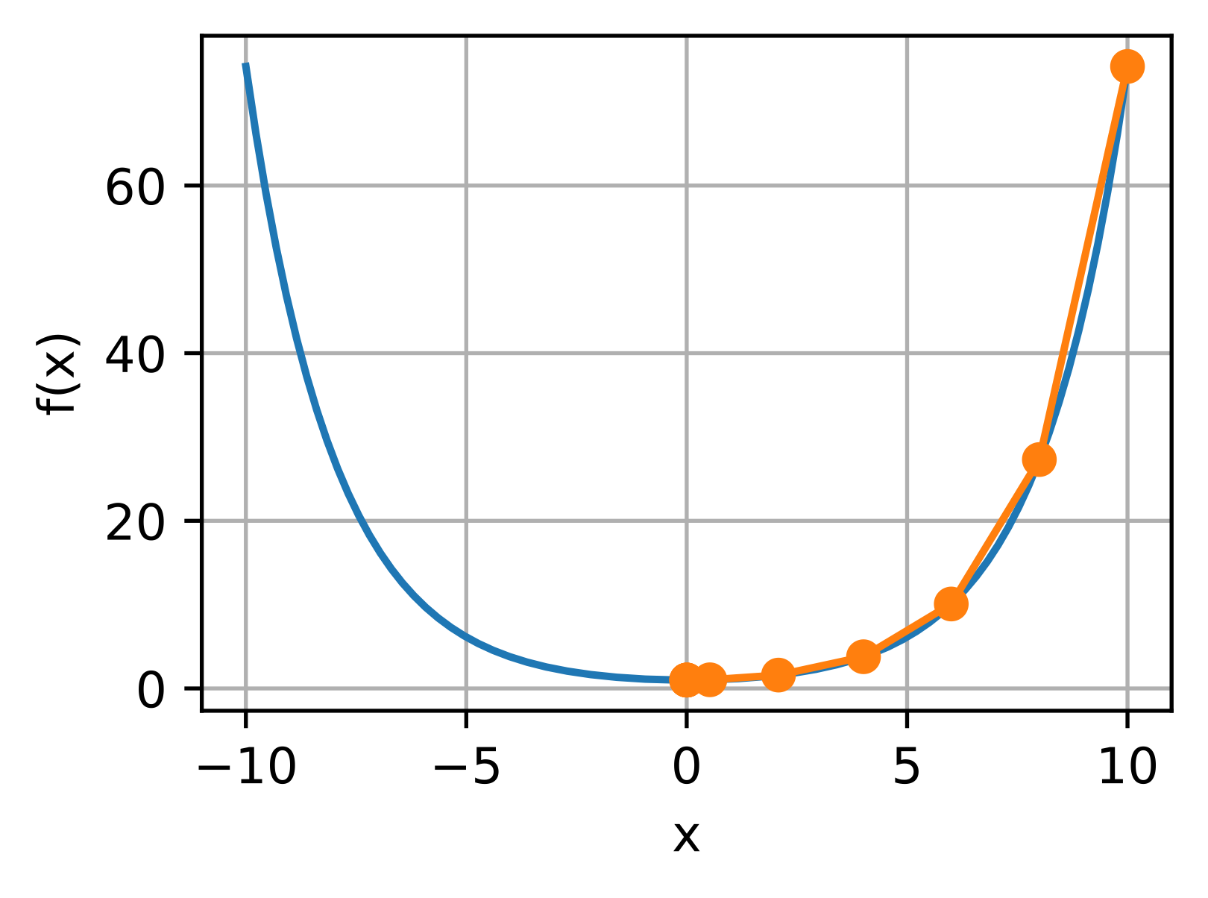
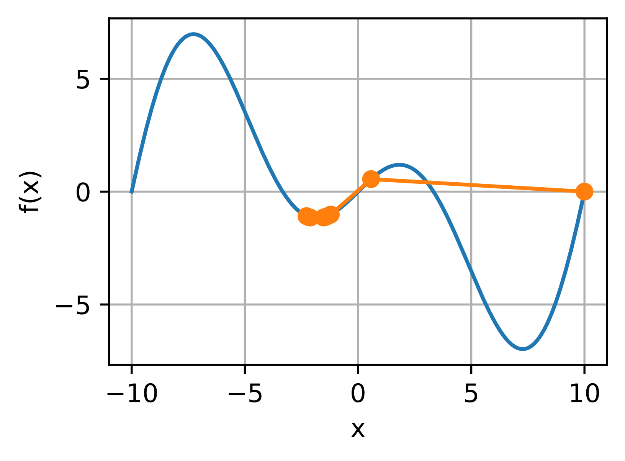
Gradient Descent Method
large
Initial Values
large
Gradient
Global Minimum
Notes:
So, indeed, In practice gradient descent is full of surprises like shown here:
[left] If the Gradient Descent update step_size is too large, the algorithm
might continually miss the optimal parameter choice,
Situation known as overshooting the minimum
[right] Or, the algorithm might jump from a good ‘global min’ neighborhood into a not so good ‘local min’ neighborhood….
(true it can also go the other way around, which would beneficial, right☺)
Basically, a suitable learning rate it’s hard to come about.
Like more other things in ML,
treat is as a hyperparameter, and start searching for the best value, usually with a validation set or k-fold CV.

Slide 54
Regularization
Notes:
Let’s talk about Regularization
And how is it used to balance model complexity and model fit, with the ultimate goal of ensuring the model generalize beyond the training dataset.

Slide 55
Regularization
Underfitting: Model too simple, fewer features, smaller weights, weak learning.
Overfitting: Model too complex, too many features, larger weights, weak generalization.
‘Good Fit’ Model: Compromise between fit and complexity (drop features, reduce weights).
Regularization does both: penalizes large weights, sometimes reduced all the way to zero!
Notes:
Let’s thing about the overfitting, underfitting, and ‘good fit’ model in the context of regression models, maybe a nonlinear logistic regression model to go with the graphics here
And, let’s remember that a learned (linear or logistic) regression model is just a collection of weights --- a w vector!
So for an Underfitting model = no much learning from the data is done, the model is usually too simple, might take into account fewer features, maybe some of the features contribute little to the model, so their multipliers/weigths are small
Visually: In the 1st plot here, you could think of a model simply considering only one of the features (x1) and deciding that ‘anything right of this value is a class, and anything left of this value is the other class’ …that’s the only ‘learning’ from the data…
Usually underfitting models don’t perform well on the training dataset, so won’t be expected, and in fact don’t perform well on future similar datasets, validation and/or test datasets.
Thinking of an underfitting model as a collection of weights, the w vector would be having many zeros (most features don’t’ contribute, don’t have a voice), or having very small values (features/data have very little to say), every feature used once …
Now, for an Overfitting model = too much learning from the data is done, the model is usually too complex, might take into account all features, and beyond, maybe some complex nonlinear combination of some of the features, with most features having a strong voice/large weights into the model
Visually: in the 2nd plot here, every feature drawing attention to individual data points, dragging and pulling the model one way of the other to accommodate all the details/noise in the dataset!
Such models would perform very well on the training dataset, learning every detail and noise in the training data,
to the extent that it might negatively impact the performance of the model on future data!
So this models don’t generalize well to new data, they merely memorize the training data!
Thinking of an overfitting model as a collection of weights, the w vector would be larger in size, and/or contain larger values
With this perspective,
- overfitting model = w vector, large size, large values = nevertheless, the best fit
- underfitting model = w vector, small size, small values, many zeros = nevertheless, the best complexity (if we think as - simpler the better!)
we can envision a ‘good fit’ model – a REGULAR model = as a compromise model,
- conceptually a compromise between fit and complexity
- having the weights vector w somewhere in between as size and values go,
not too few, not too many features and not too small, not too large weights!
Wouldn’t be nice to be given a slider to find that sweet spot, that right balance of fit and complexity
That would give us a model that performs well on training and validation?!
Such a miraculous slider exists, it’s called a regularizer!
So here enters regularization – a ML technique that helps over/underfitting models adjust to be more useful on both training and validation sets,
Most of the time regularization is used to control overfitting,
by penalizing large weights, sometimes reducing some all the way to zero (in which case is the corresponding features are dropped all together!)

Slide 56
Regularization
Tune model complexity by adding a penalty score for complexity to the cost function (think error function, minimizing towards best fit!):
Calibrate regularization strength by using a regularizer parameter, $α$
Standard regularization types:
L2 regularization (Ridge): (L2: popular choice)
L1 regularization (LASSO):
Both L2 and L1 (ElasticNet)
(L1: useful as feature selection, since most weights shrink to 0 - sparsity)
Note: Important to scale features first!
Notes:
So how does regularization accomplish this, penalizing large weights?
Let’s first remember how these weights are being learned (so large) to begin with:
By minimizing an error function, here C(w) with respect to w, aiming for the best fit of the model to the data!
It kind of make sense then, to think that, aiming for best complexity as well,
some complexity fct could be also minimized with respect to w
That fct is traditional called in ML, a penalty
And, so, to regularize an ML model, is basically minimizing the extended error/cost_regularized function of w,
Still minimizing the original error /cost fct for a good fit,
at the same time with minimizing the complexity of the model, for a simpler model!
Note the regularizer parameter alpha that can be used to calibrate/control the strength of the regularization:
If alpha = 0, no penalty for complexity is applied, and therefore the model will concentrate on the best fit alone (most probably overfitting by driving the errors as low as possible!)
If alpha is too big, the penalty on complexity would be very strong, leading to very simple models (most probably underfiting models!)
Hard know what’s best value of alpha for your data, your model
Treat alpha as a hyperparameter – selected the best value using a validation set/k-fold CV
Now, we know how the error fct might look like (SSE, LOgLoss), but how about this penalty(w)?
Two popular penalties/regularization procedures are:
Ridge Regression/aka L2 regularization: popular regularization choice, penalizes the model by minimizing the sum of the squared values of all features weights
– will try to uniformly make all weights smaller, but not necessarily driving them to zero!
Whereas,
Lasso Regression (short for Least Absolute Shrinkage and Selection Operator)/aka L1 regularization:
Is penalizing the sum of the absolute values of all features weights,
shrinkimg some weights all the way to 0, due to the geometry of the L1 norm/abs value!
– L1 regularization is therefore performing feature selection
– if the weights are learned to be zero, that means the corresponding features were deemed unnecessary, the model won’t use them!
(this is particularly essential when the dimensionality of the dataset got out of hand by feature engineering, let’s say!)
There is also a combination of both techniques, called elastic net – that’s applying both penalties, usually with the effect of a compromise between the two
Last, but by no means least: As with any other metric-based procedures, to avoid any scaling issues, before regularization remember to scale your features first!
~~~~~~~
penalty(w) = \left\lVert w \right\rVert _{2}^{2} = \sum {w_i ^2 }
C_{regularized} (w) = C(w) + \alpha * penalty(w)

Slide 57
Regression in sklearn
LinearRegression: sklearn Linear Regression (and regularization)
LinearRegression()
Ridge(alpha=1.0), RidgeCV(alpha=1.0, cv=5)
Lasso(alpha=1.0), LassoCV(alpha=1.0, cv=5)
ElasticNet(alpha=1.0, l1_ratio=0.5), ElasticNetCV(cv=5)
LogisticRegression: sklearn Logistic Regression (and regularization)
LogisticRegression(penalty='l2', C=1.0, l1_ratio=None)
LogisticRegressionCV(penalty='l2', C=1.0, l1_ratio=None, cv=5)
Notes:
Now that you know some techniques to learn the coefficients in a linear and/or logistic regression model,
and how to adjust overfitting/underfitting models,
let’s see how you can use regression models in practice with sklearn:
There are a few linear regression implementations in sklearn, one with no regularization, as the
LinearRegression - fits a linear model by computing a solution to minimize SSE using matrix formulas – and runs into issues when features are highly correlated, producing large variance in results.
Ridge regression addresses some of the problems of LinearRegression by imposing a L2 penalty
Note that regularization is applied by default
The regularizer parameter α≥0 controls the amount of regularization: the larger the value of α, the greater the amount of regularization/shrinkage and thus the coefficients become more robust to collinearity.
RidgeCV implements ridge regression with built-in cross-validation of the alpha parameter (cv=5)
If rather try L1 penaly,
Lasso , LassoCV are also available
LogisticRegression, and LogisticRegressionCV, with built-in cross validation…
- all regularizations done here, choose by ‘penalty’ parameter
- Note that regularization is applied by default, and is using a slightly diff regularizer parameter – attached to the cost fct not the penalty!
- C = 1/alpha
the larger the value of C, the lower the amount of regularization …

Slide 58
Linear Regression – Hands-on
Exercise: Training a regressor to predict the log_votes field for the review dataset:
The exercise covers the following topics:
ML Model: Linear Regression
Regularization: L1 (LASSO), L2 (Ridge), and Elastic Net
MLA-NLP-Lecture2-Linear-Regression.ipynb

Slide 59
Hyperparameter Tuning
Notes:
Let’s talk about hyperparameter tuning.
As ML models get more sophisticated, there are more architectural decisions to be made.
We discuss a few methods to tweak/tune ML architectural choices – the so called hyperparameters, to improve model performance.

Slide 60
Hyperparameter Tuning
Hyperparameters are ML algorithms parameters that affect the structure of the algorithms and the performance of the models.
Examples of hyperparameters:
K Nearest Neighbors: n_neighbors, metric
Decision trees: max_depth, min_samples_leaf, class_weight, criterion
Random Forest: n_estimators, max_samples
Ensemble Bagging: base_estimator, n_estimators
Hyperparameter tuning looks for the best combination of hyperparameters (combination that maximizes model performance).
Notes:
Let’s first see what are Hyperparameters?
Hyperparameters = parameters that affect the performance and structure of an ML algorithm, that is are
ML alg’s parameters, specified when configuring the ML training, before model training and testing:
Such as:
K Nearest Neighbors: n_neighbors, metric
Decision trees: max_depth, min_samples_leaf, class_weight, criterion
Random Forest: n_estimators, max_samples
Ensemble Bagging: base_estimator, n_estimators
These are not the same as the ML model’s parameters (think weights attached to each of your model features),
that are learned from the data, learned or found by the ML algorithm!
Now, back to hyperparameters,
different choices of hyperparameters could lead to different model performance metrics,
Such as changing the number of K nearest neighbors, or the depth of a decision tree, or the number of trees in the random forest,
knowing exactly what values would maximize learning, and therefore model performance, is …challenging.
finding the right values can be difficult. Typically, you’ll start with something random and iterate through adjustments as you begin to see what effect the changes have. It can be a long cycle depending on how many hyperparameters your model has.
The search, the hunt, for this best combination of hyperparameters,
as you tweak one or another to improve a desired performance metric, is called
Hyperparameter tuning.
As any good ML project relies on knowing what best values to use for the hyperparameters of a given algorithm on a given dataset,
All ML libraries and ML platforms have a few choices/implementations of hyperparameter tuning aka hyperp optimization!

Slide 61
Grid Search in sklearn
GridSearchCV: sklearn basic hyperparameter tuning method, finds the optimum combination of hyperparameters by exhaustive search over specified parameter values -
GridSearchCV(estimator, param_grid, scoring=None)
Example: Hyperparameters for a Decision Tree:
param_grid ={max_depth: [5, 10, 50, 100, 250],
min_samples_leaf: [15, 20, 25, 30, 35]}
.fit(), .predict()
Hyperparameter 2
Hyperparameter 1
Total hyperparameters combinations
5 x 5 = 25
[5, 15], [5, 20], [5, 25], [10, 15], …
Notes:
GridSearchCV is sklearn basic hyperparameter tuning method,
finds the optimum combination of hyperparameters
by exhaustive search over specified parameter values
Example: Hyperparameters for a Decision Tree:
Estimator = tree; scoring = your choice of model perf metric,
and most importantly, param_grid { max_depth: [5, 10, 50, 100, 250], min_samples_leaf: [15, 20, 25, 30, 35]}}
That is, we would be interested to try these 5 choices for the …, in combination with these 5 choices for …
That would be quite a few scenarios we would like to try, like [5, 15], [5, 20], [5, 25], [10, 15], and so on…
That will be 25 different scenarios, or better said hyperparameters combinations.
Note that GridSearchCV can be used as an estimator, with a fit and predict methods,
and as the name suggests it is also performing 5-fold CV by default for each combination of hyperparameters.
(that also another hyperparameter, of the GridSearchCV, that you might want to tweak!)
That is, The parameters of the estimator used to apply these methods are optimized by cross-validated search over parameter settings.
So for each fit call on the training set, the GridSearchCV estimator will
build, train and validate as many CV models as mentioned by the cv hyperparameter!
For example, for our case here, with 25 combinations and hyperparameters, and say default CV of 5,
would train and validate 25x5 that is 125 models!
Beware, this might take some time!
Once all the combinations are evaluated, the model with the set of parameters which give the top metric is considered to be the best.
GridSearchCV returns the best combination of the hyperp,
the best estimator equipped with these best hyperp,
and will also report the performance metric of this best estimator.
Sounds great, but remember, GridSearch can take a long time to complete, so does not scale well!
If we would like to add more hyperparameters to the grid, which you might definitely want to do for real life ML projects,
the grid gets huge number of combinations/nodes/
And because is doing exhaustive search,
moving sequentially from one combination to another,
might spend much of this time in hyper space regions with no benefits/low metrics
Until moving into more promising regions.

Slide 62
Randomized Search in sklearn
RandomizedSearchCV: randomized search on hyperparameters
Chooses a fixed number (given by parameter n_iter) of random combinations of hyperparameter values and only tries those.
Can sample from distributions (sampling with replacement is used), if at least one parameter is given as a distribution.
RandomizedSearchCV(estimator, param_distributions,
n_iter=10, scoring=None)
Example: Hyperparameters for a Decision Tree:
param_grid ={max_depth: [5, 10, 50, 100, 250],
min_samples_leaf: uniform(15,35,5)}
Hyperparameter 2
Hyperparameter 1
Notes:
A more efficient implementation of hyperparameter tuning in sklearn is RandomizedSearchCV
In contrast to GridSearchCV, not all parameter values are tried out,
but rather a fixed number of parameter settings is sampled from the specified distributions.
The number of parameter settings that are tried is given by n_iter.
If all parameters are presented as a list, sampling without replacement is performed.
If at least one parameter is given as a distribution, sampling with replacement is used.
It is highly recommended to use continuous distributions for continuous parameters.
Example: Hyperparameters for a Decision Tree:
Estimator = tree; scoring = your choice of model perf metric,
param_distributions
{ max_depth: [5, 10, 50, 100, 250],
min_samples_leaf: 5 values form the unif distribution between 15 and 35 uniform(15,35,5)}}
And n_iter (default 10) = Number of random parameter settings that are sampled.
n_iter trades off runtime vs quality of the solution., we would be interested to try these 5 choices for the …,
Note that RandSearchCV also performs 5-fold CV by default for each combination of hyperparameters!
So for our case here, if n_iter is 7, we will wait for 7x5 = 35 models to be trained and validated before RandSearchCV is completed!
With trying only 7 combinations practically out of the 25 GridSearch did, over similar range of parameters,
Is RandomizedSearch not only faster but as good as GridSearch?
While we are not guaranteed to identify the best combination since not all combinations will be tested,
RandSearch will randomly hit/try various hyperparameter regions/combinations and
Increasing the chances to find models that are as good within a small fraction of the computation time.
One fair question would be, while on our random search hitting diff hyperparam combinations and computing model metrics,
Why not stop/search more in the regions that look more promising?

Slide 63
Bayesian Search
Bayesian Search method keeps track of previous hyperparameter evaluations and builds a probabilistic model.
It tries to balance exploration (uncertain hyperparameter set) and exploitation (hyperparameters with a good chance of being optimum)
It prefers points near the ones that worked well
AWS SageMaker uses Bayesian Search for hyperparameter optimization.
Notes:
One fair question would be, while on our random search hitting diff hyperparam combinations and computing model metrics,
Why not stop/search more in the regions that look more promising?
And then, it is Bayesian Search
method keeps track of previous hyperparameter evaluations and builds a probabilistic model around it.
It tries to balance exploration (uncertain hyperparameter set) and exploitation (hyperparameters with a good chance of being optimum)
It prefers points near the ones that worked well
AWS SageMaker uses Bayesian Search for hyperparameter optimization.

Slide 64
Trees and Hyperparameter Tuning – Hands-on
Exercise: Training classifiers to predict the isPositive field for the review dataset:
The exercise covers the following topics:
ML Model: Decision Trees and Random Forests
Hyperparameter Tuning: Grid and Randomized search
MLA-NLP-Lecture2-Tree-Models.ipynb

Slide 65
AWS AI/ML Services

Slide 66
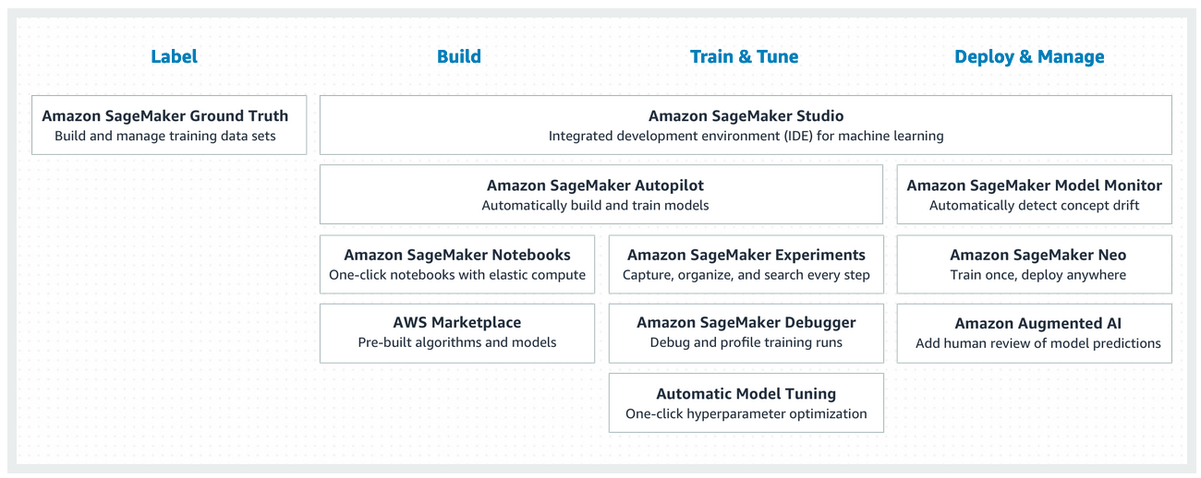
AWS SageMaker: Train and Deploy
SageMaker is an AWS service to easily build, train, tune and deploy ML models: https://aws.amazon.com/sagemaker/
MLA-NLP-Lecture2-Sagemaker.ipynb
Notes:
SageMaker's a fully managed service that removes the heavy lifting from each step of the machine learning process: to build, train, tune, and deploy an ML model. Right from the get go, literally with one click, you have access to a fully managed machine learning notebook environment using the popular Jupyter format.
Apart from using SageMaker to build or bring your own ML models to Jupiter notebooks, you can also use one of the 17 build-in models that SageMaker has, or reach out to the AWS Marketplace for more custom models.
Since launch, AWS has regularly added new capabilities to Amazon SageMaker, with more than 50 new capabilities delivered over the past 12 months. These capabilities have helped many more developers build custom machine learning models.
In particular, Amazon SageMaker makes Hyperparamter Tuning easy by offering Automatic Model Tuning as an option during training. Automatic model tuning uses machine learning to quickly tune your model to be as performant as possible. This capability lets you skip the tedious trial-and-error process of manually adjusting hyperparameters.
Let’s see how one of the build-in SM models and Hyperparamter Tuning work in practice, on our review dataset:
Let’s open the Jupiter notebook for a walkthrough.

Slide 67
Amazon Comprehend
Comprehend is a AWS NLP service that allows users to gain insights from text data and build ML models.
In this section, we will implement a custom text classifier using AWS Comprehend.
Main steps:
1. Creating the classifier
2. Putting data into correct format.
3. Training
4. Make predictions (inference)

Slide 68
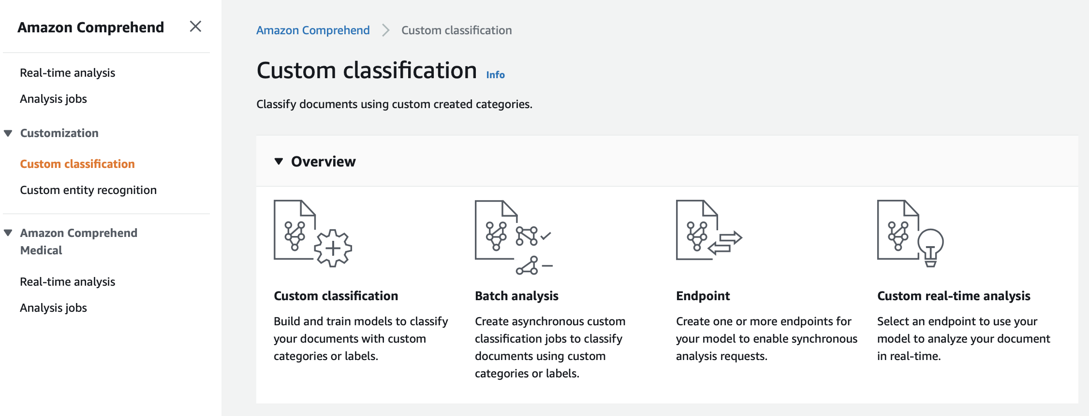
Custom Classification

Slide 69
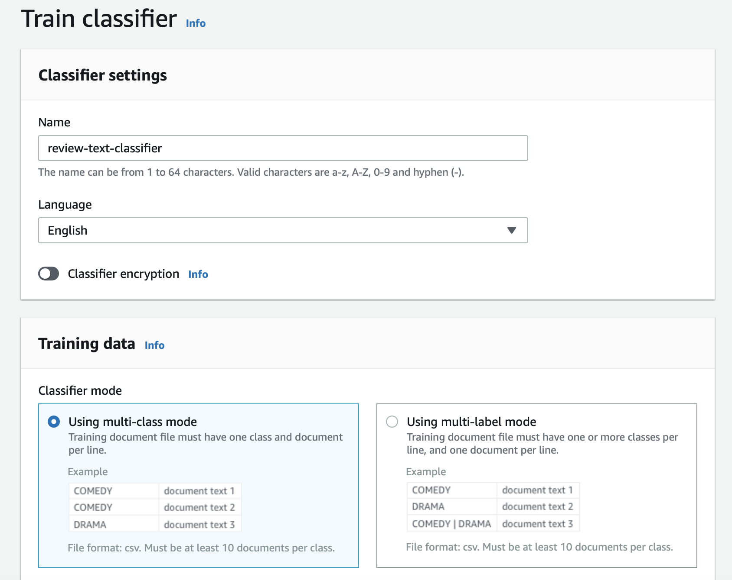
Train classifier
Select “train classifier” under custom classification.
We will enter the name and select the classifier mode.
Let’s use the multi-class mode. Each line is a text and can belong to a single class.

Slide 70

Input data format
Training data is provided in a CSV file (comp_final_training.csv).
First column is the class and second column is the text we will use.
It will be uploaded to a S3 Bucket.

Slide 71
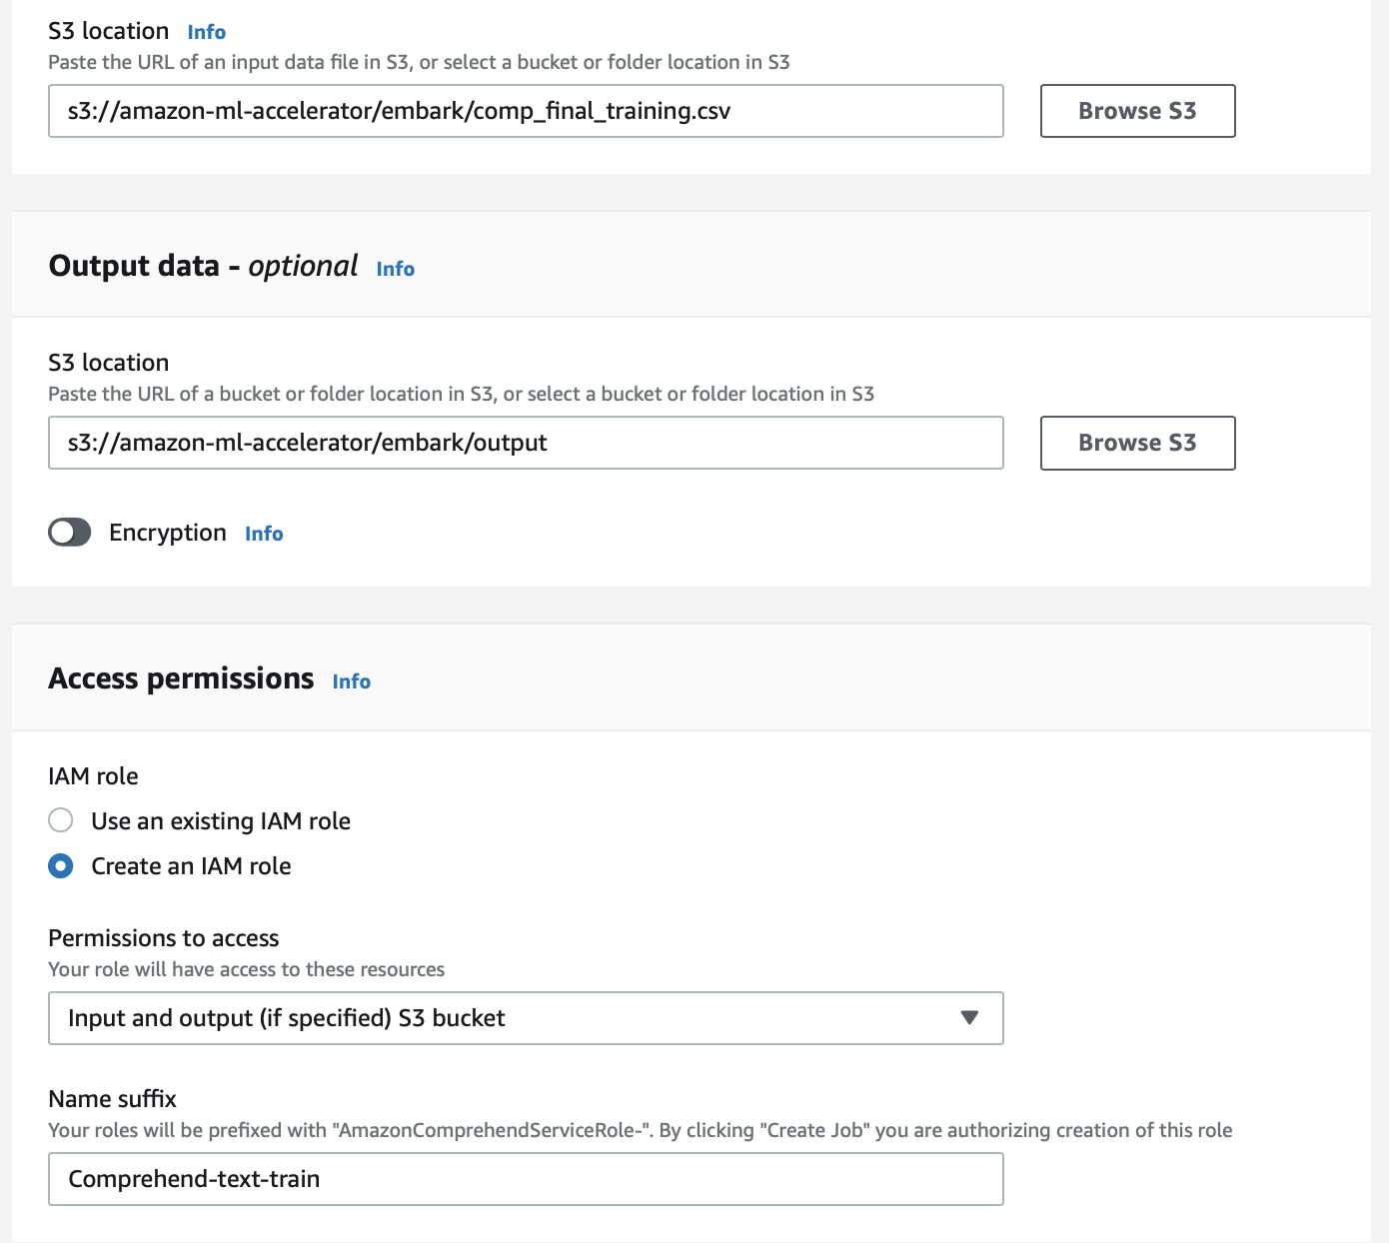
Train classifier
S3 paths for data input and output folders are entered.
Create an access permission for training

Slide 72
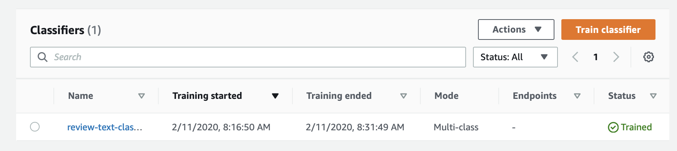
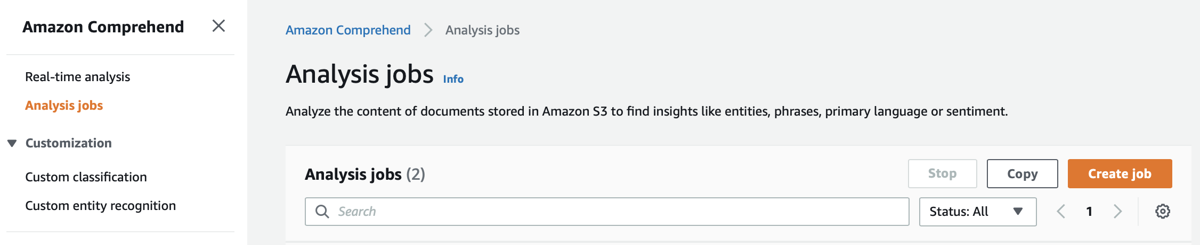
Create an Analysis Job

Slide 73

Test data
Test data is provided in a CSV file (comp_final_test.csv).
Single column for text data
It will be uploaded to a S3 Bucket.

Slide 74
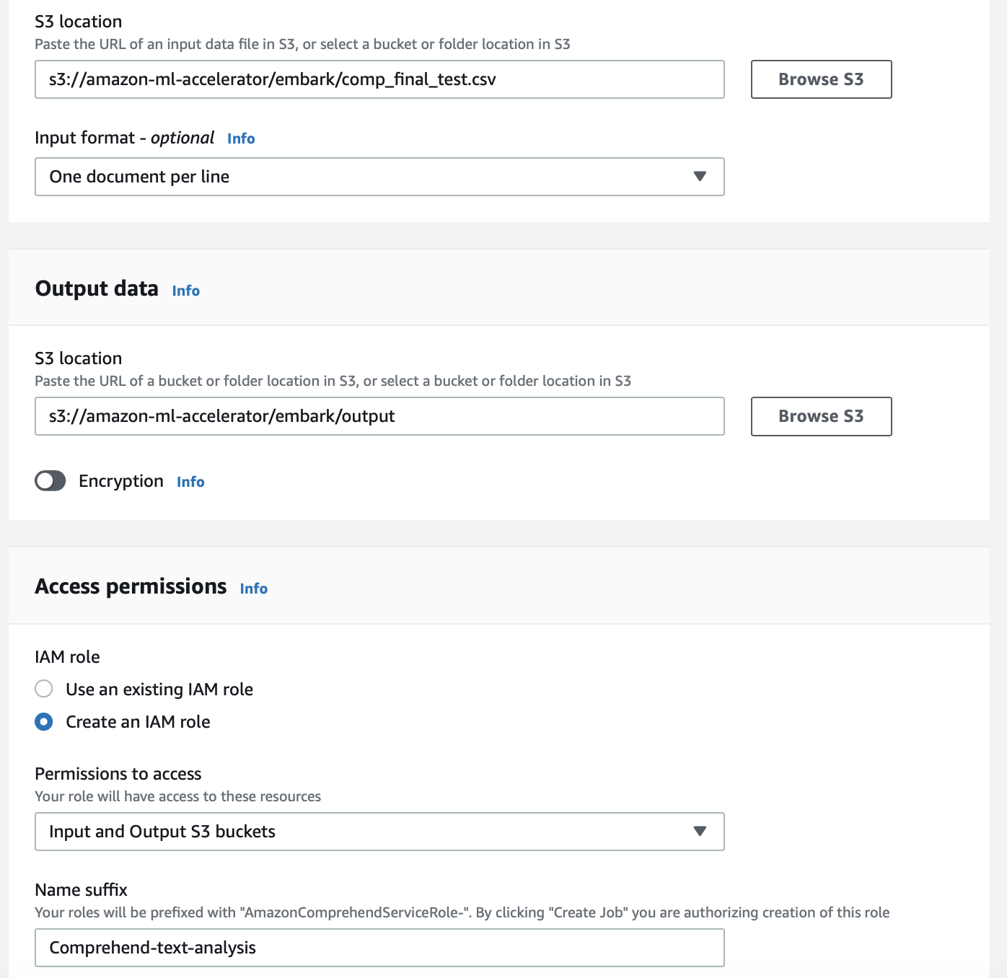
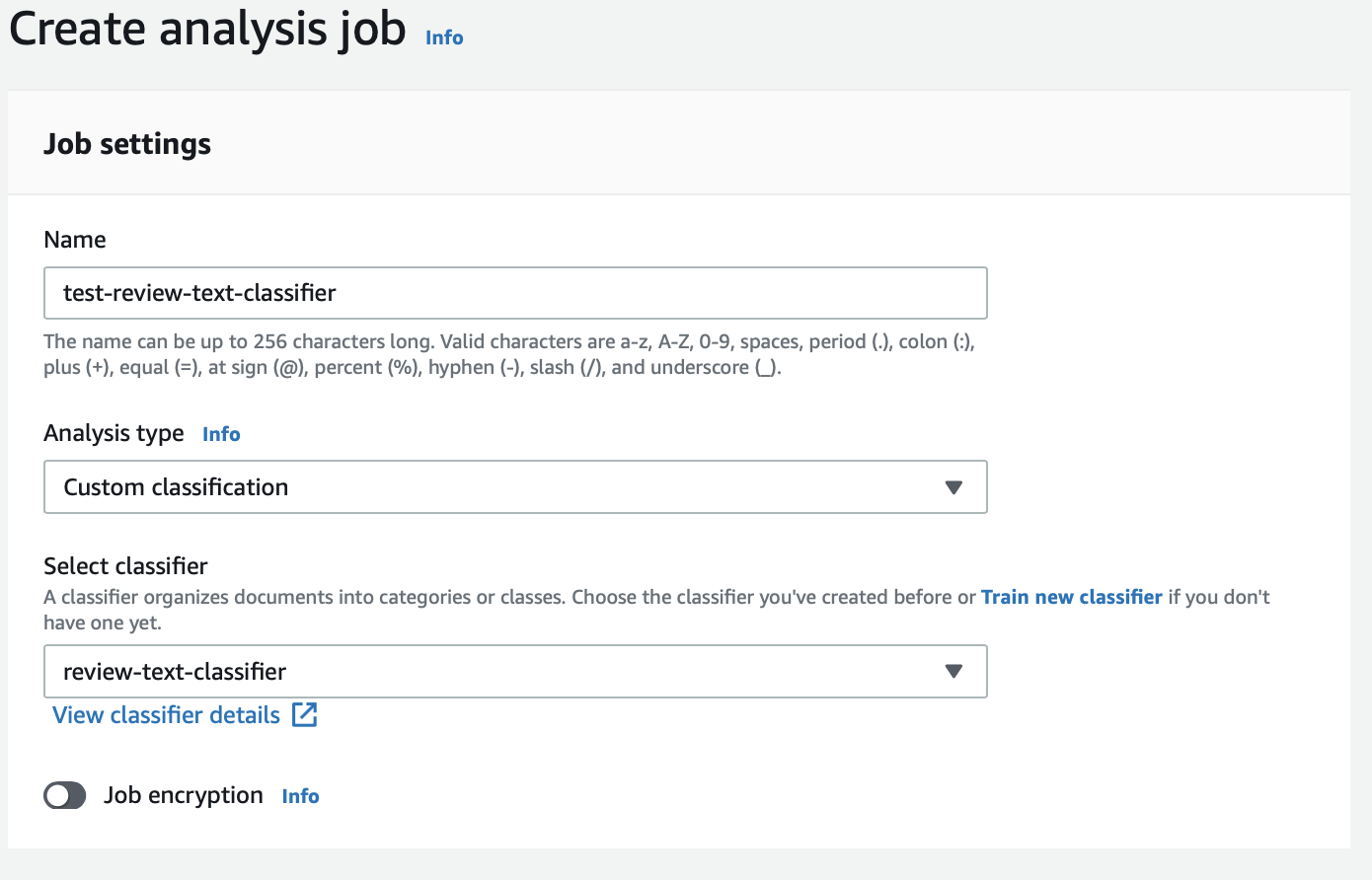
Create an Analysis Job

Slide 75
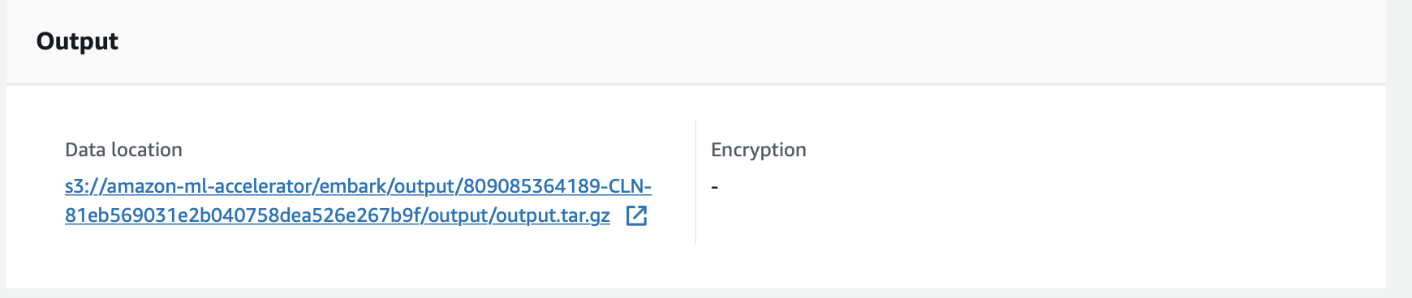
Output of the Analysis Job
Once the analysis completed, the status will turn to “Completed”. Click on the classifier under its name
Output files are saved in the link below.

Slide 76
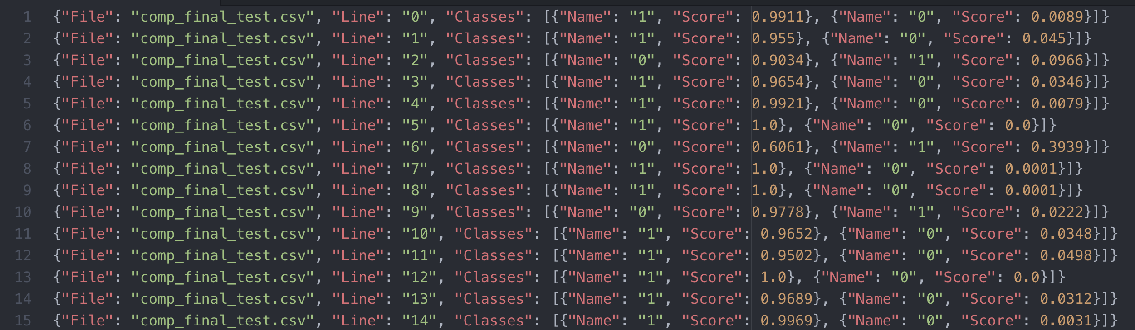
Predictions
Extract the output files and get the json file: predictions.json

